Slide 1
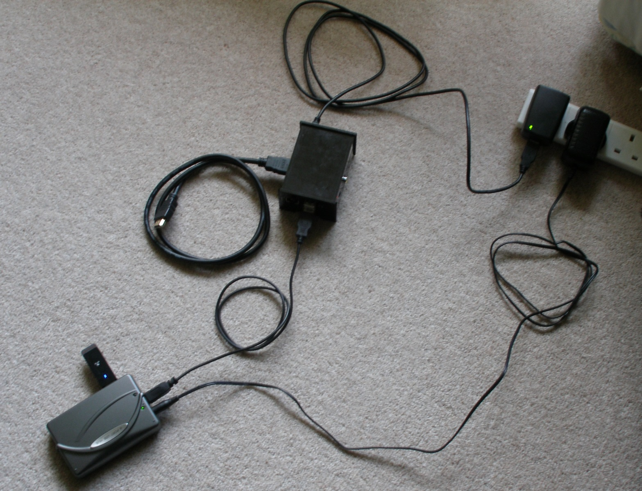
5V 2A
USB Power
supply
HDMI
port
RasPi
Model B
in case
HDMI
cable to
HDTV
USB port
Wifi
dongle
USB Hub

